Slide 1
Lifted Bijections for Low Distortion Surface Mappings
Noam Aigerman Roi Poranne Yaron Lipman

Slide 2
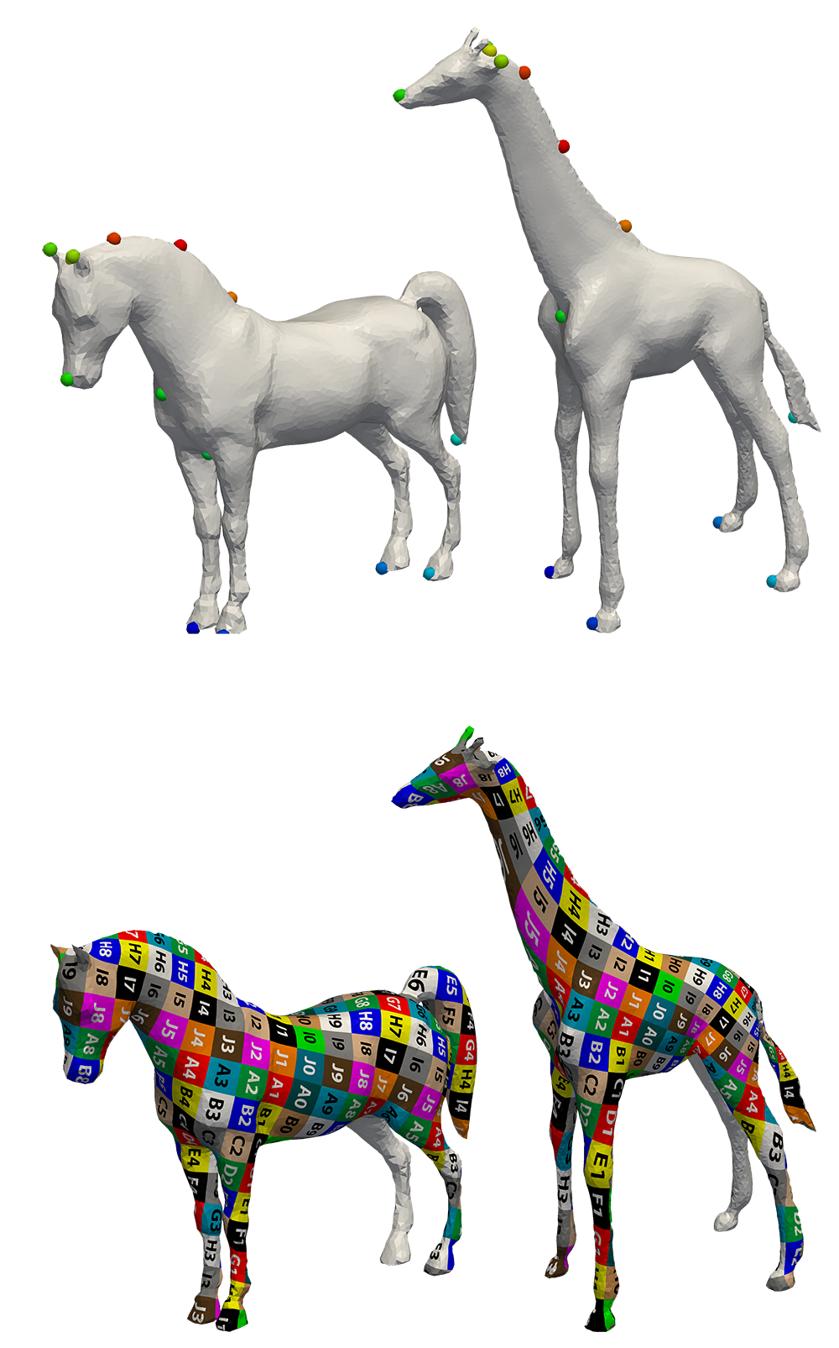
In this talk:
High quality, bijective mappings between surface meshes

Slide 3
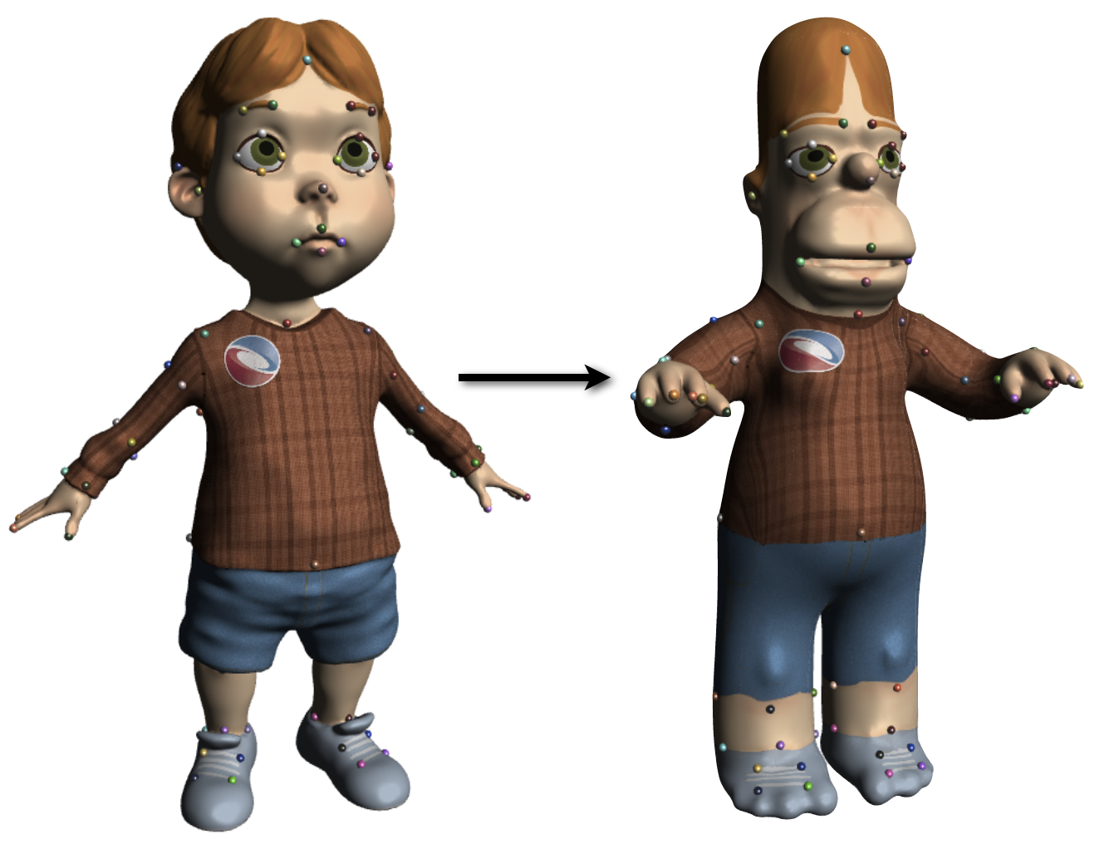
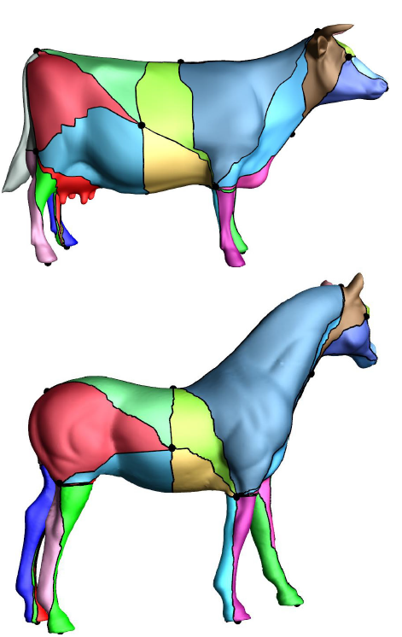
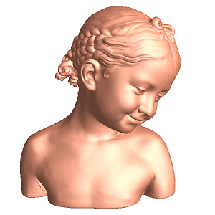
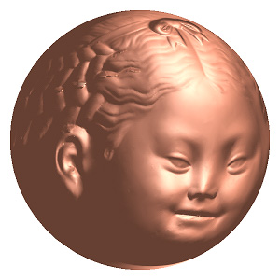
We need Surface Maps!
[Panozzo et al. 13]
[Kim et al. 11]
[Ovsjanikov et al. 12]
Non-bijective
Bijective, simple algorithm
[Kraevoy and Sheffer 04]
[Schreiner et al. 04]
[Jin et al. 08]
Bijective, intricate algorithm

Slide 4
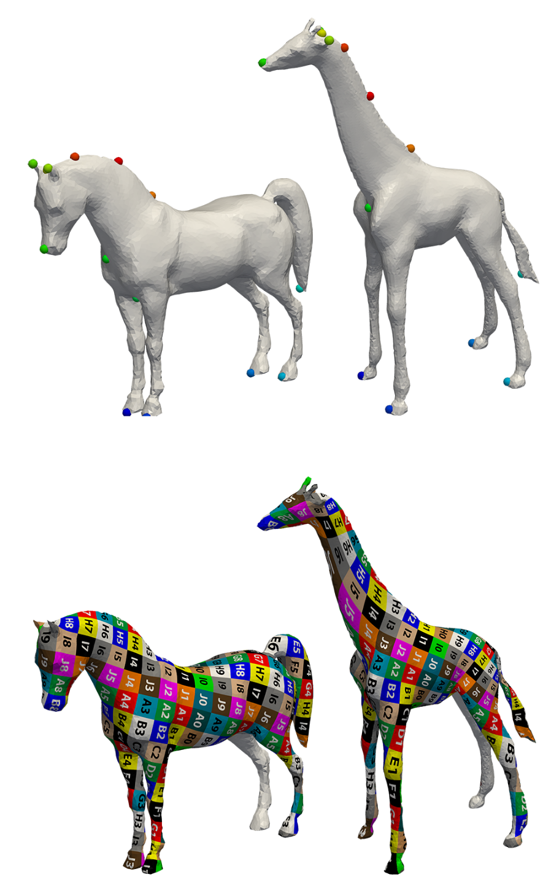


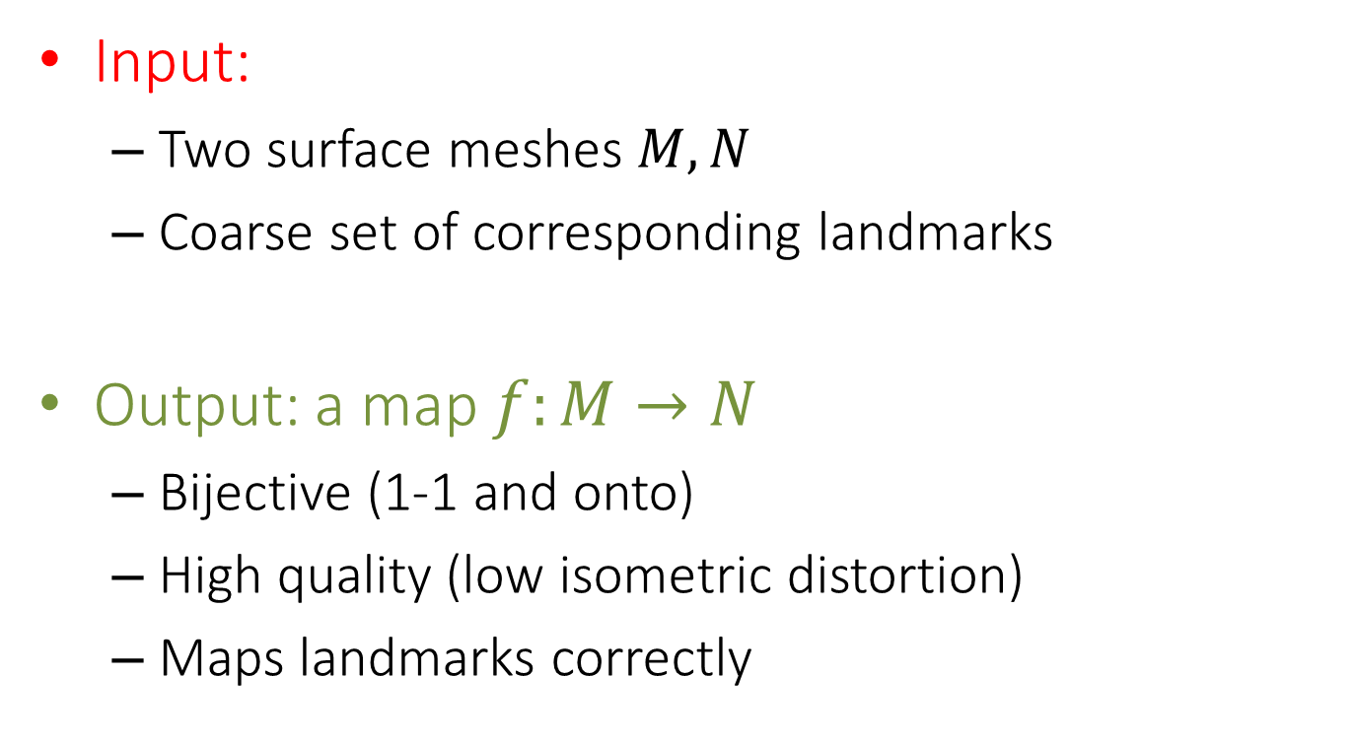
Goal
$$M$$
$$N$$
Input:
Two surface meshes $M,N$
Coarse set of corresponding landmarks
Output: a map $f:M→N$
Bijective (1-1 and onto)
High quality (low isometric distortion)
Maps landmarks correctly

Slide 5
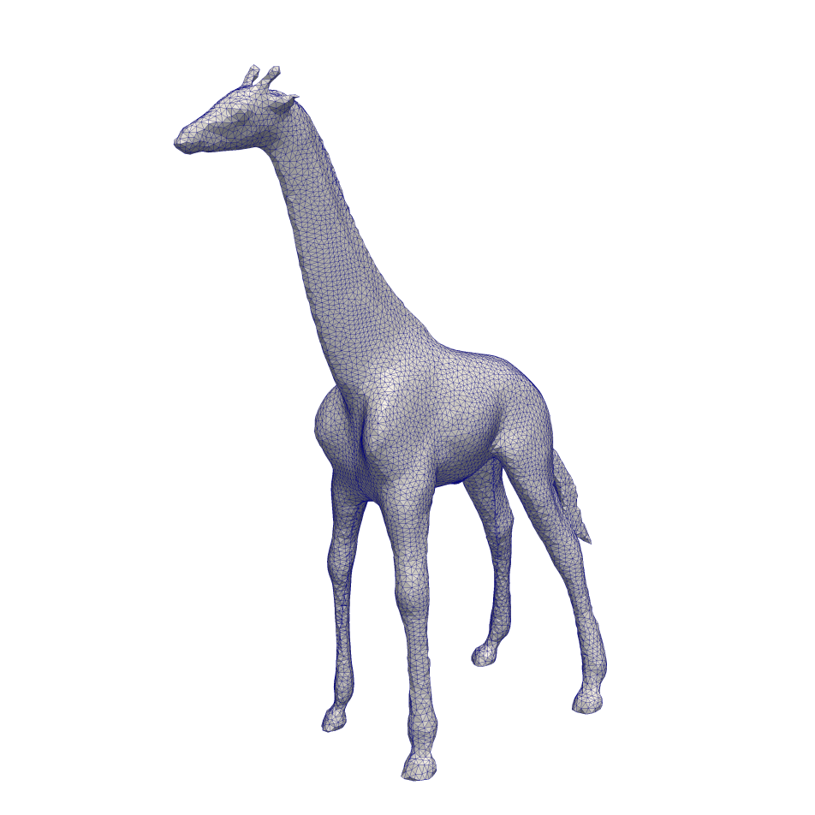
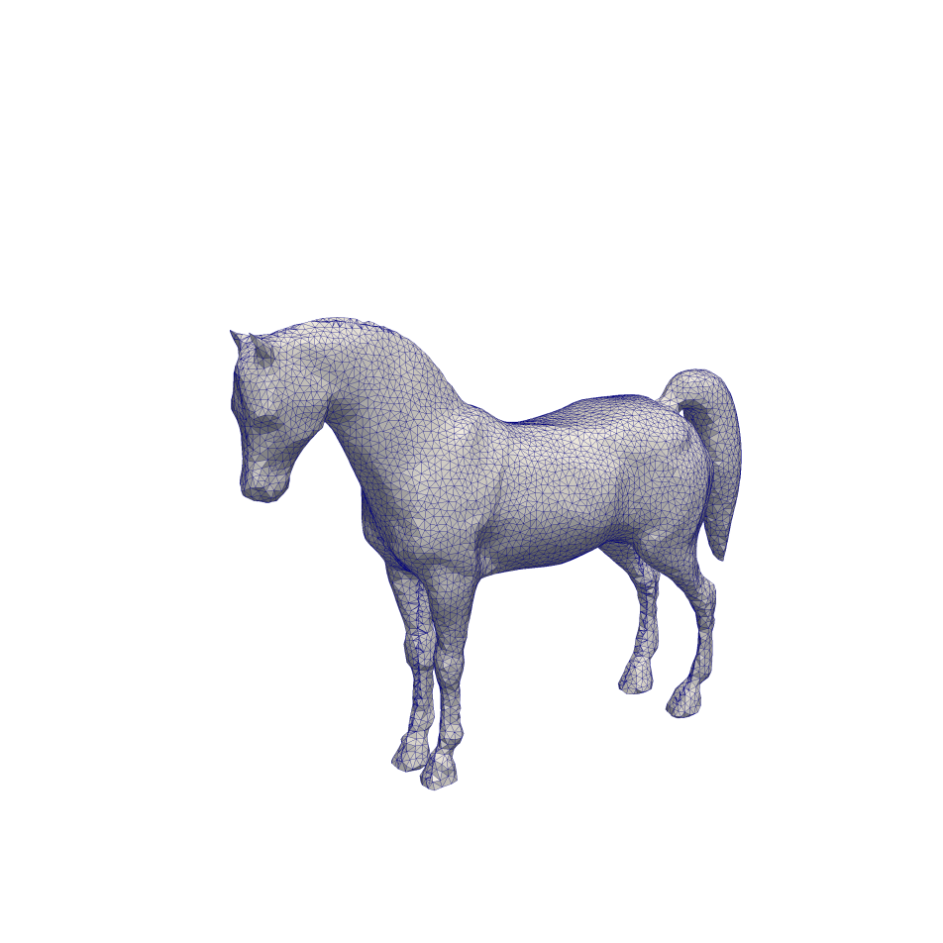




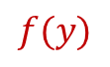
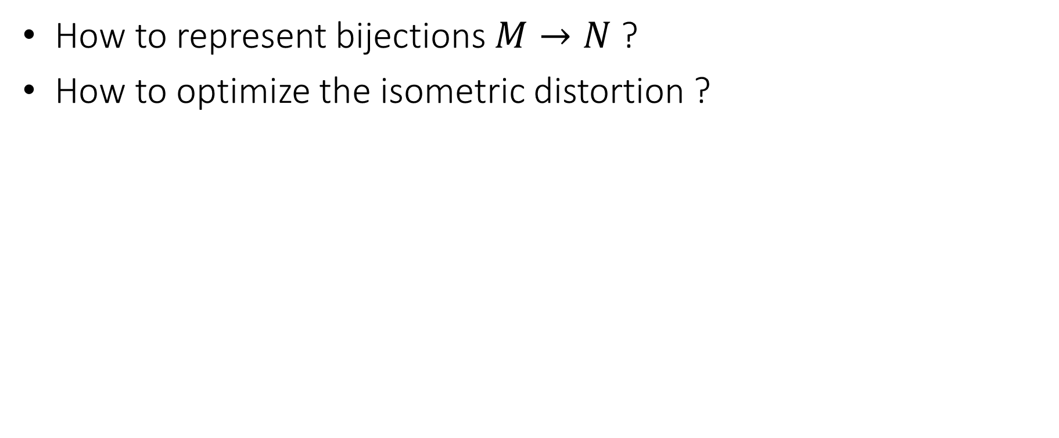
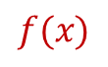
Challenges
How to represent bijections $M→N$ ?
How to optimize the isometric distortion ?
$$f(x)$$
$$f(y)$$
$$x$$
$$y$$
$$M$$
$$N$$

Slide 6


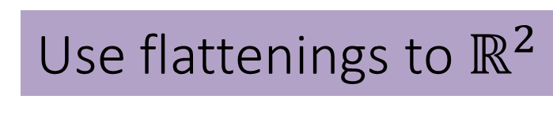


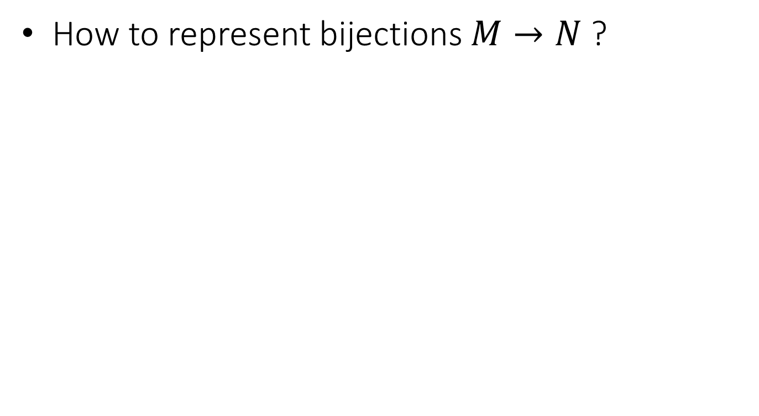
Challenges
Use flattenings to $ℝ^{2}$
How to represent bijections $M→N$ ?
$$Φ$$
$$Ψ$$
$$M$$
$$N$$

Slide 7

Use flattenings to $ℝ^{2}$
Connect landmarks with curves
Extend landmark correspondence to the curves

Slide 8
Cut the mesh and map to disk

Slide 9
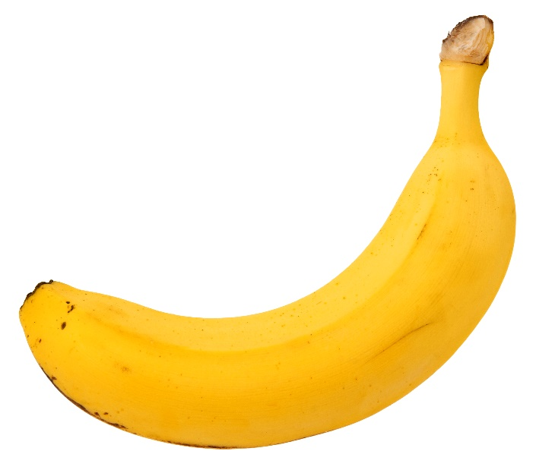
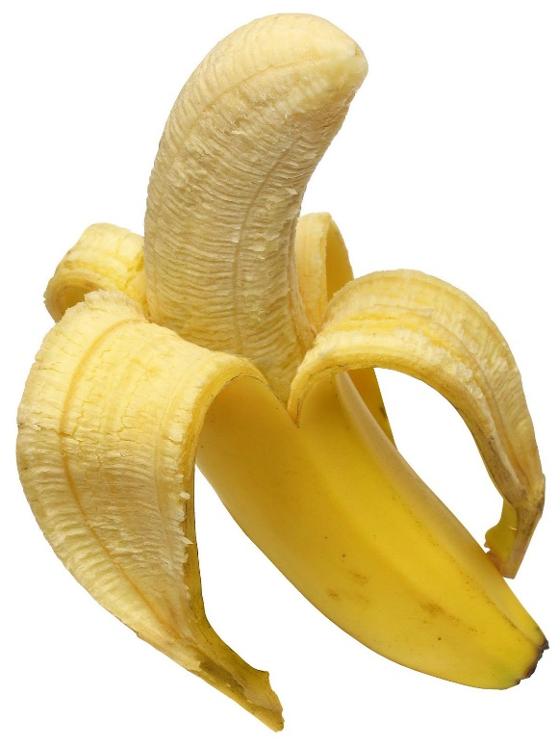
Cut the mesh and map to disk

Slide 10



Flattenings to $ℝ^{2}$
$$Φ$$
This defines a bijection between the meshes!
$$Ψ$$
bijective
Bijective
bijective
Boundaries are identical

Slide 11
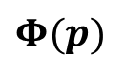
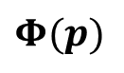

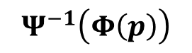

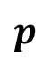
Recovering the bijection
$$f$$
$$=Ψ^{−1}∘Φ$$
$$p$$
$$Ψ^{−1}\left(Φ\left(p\right)\right)$$
$$Φ$$
$$Φ$$
This defines a bijection between the meshes!
$$Ψ$$
bijective
bijective
$$Φ(p)$$
$$Φ(p)$$

Slide 12
Recovering the bijection
$$f$$
$$=Ψ^{−1}∘Φ$$
$$Φ$$
$$Φ$$
$$Ψ$$
bijective
bijective
Continuous across cuts!

Slide 13
Is this good enough?
$$f$$
$$=Ψ^{−1}∘Φ$$
$$Φ$$
$$Φ$$
$$Ψ$$

Slide 14
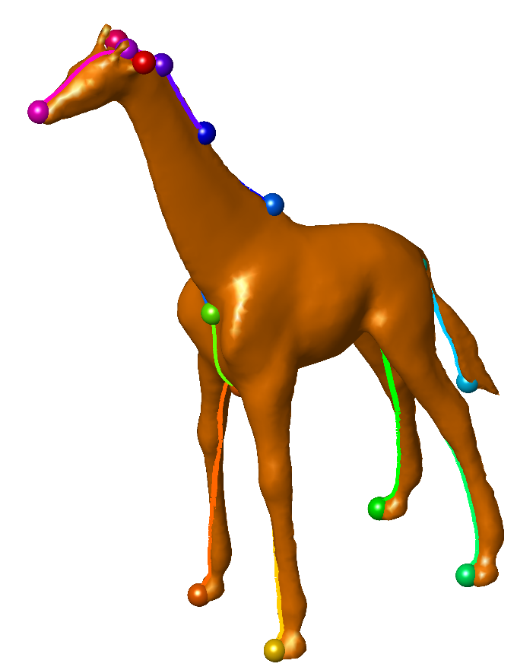
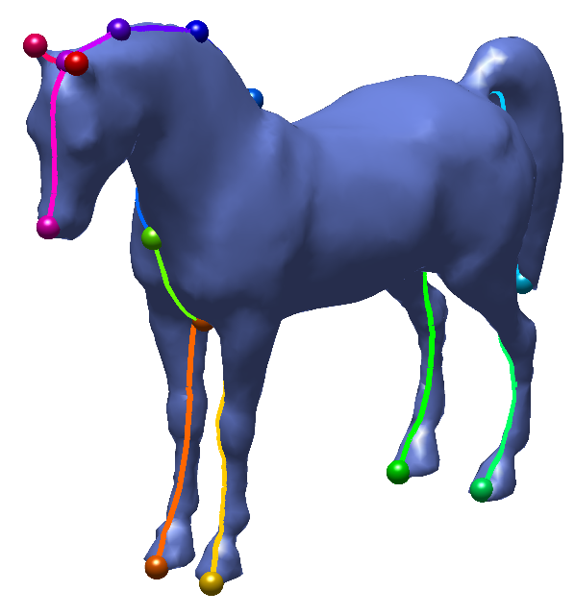


Is this good enough?
$$f$$
$$=Ψ^{−1}∘Φ$$
Tutte’s embedding
$$Φ$$
$$Ψ$$
Bijective
bijective
bijective
Boundaries are identical

Slide 15
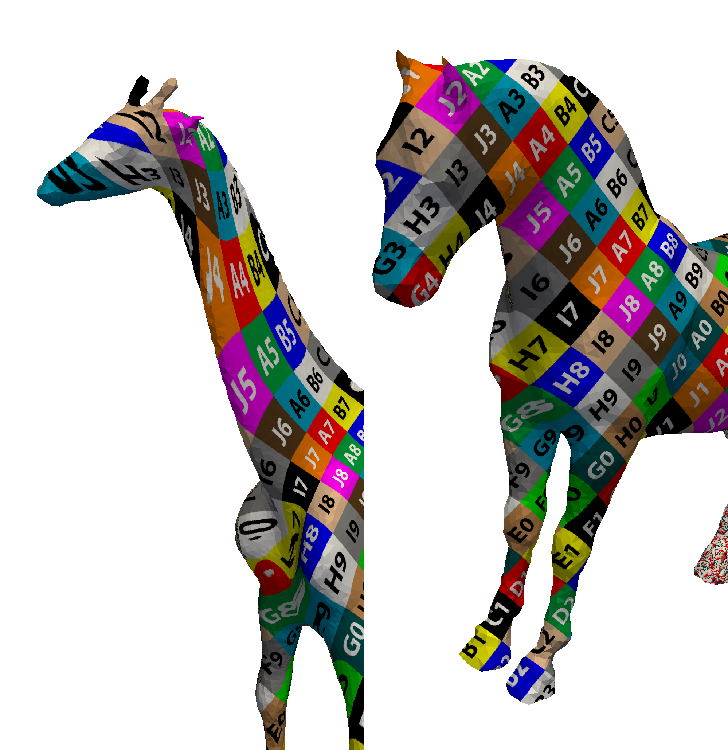
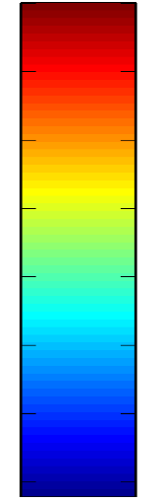


Is this good enough?
$$f$$
$$=Ψ^{−1}∘Φ$$
Distortion
$$Φ$$
$$Ψ$$

Slide 16
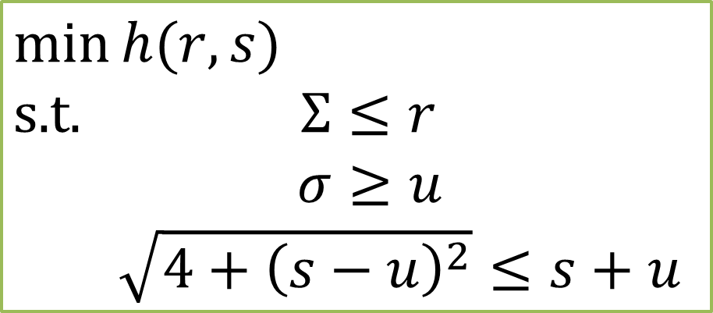
Reduce the flattenings’ distortion!
$$f$$
$$=Ψ^{−1}∘Φ$$
Novel optimization algorithm
$$\min{h(r,s)}$$
$$\text{s}\text{.}\text{t}\text{. } Σ≤r$$
$σ≥u$
$\sqrt{4+{\left(s−u\right)}^{2}}≤s+u$
Problem: fixed boundary causes distortion
Distortion
$$Φ$$
$$Ψ$$

Slide 17


Let the boundaries move!
$$f$$
$$=Ψ^{−1}∘Φ$$
Distortion
$$Φ$$
$$Ψ$$

Slide 18
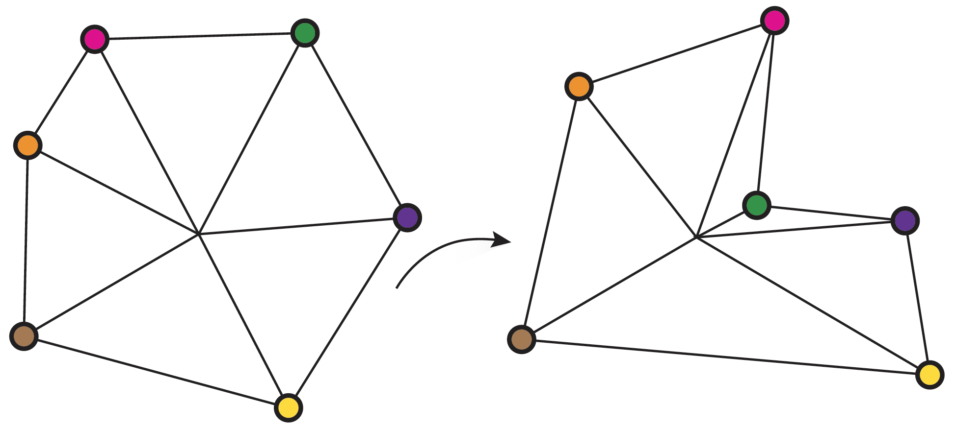
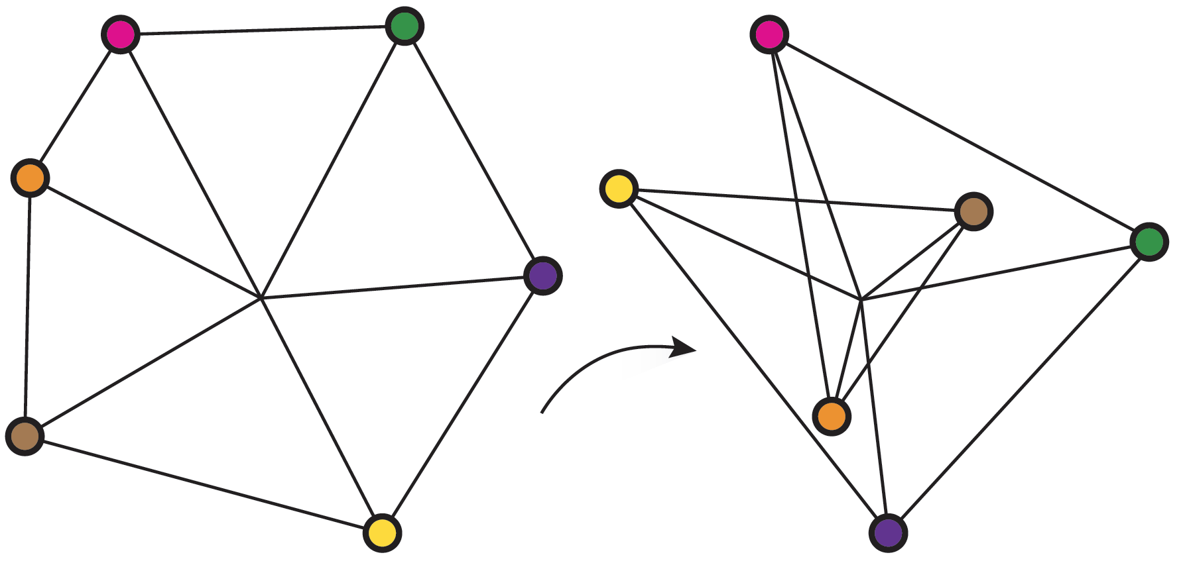


Let the boundaries move!
$$Φ$$
$$Φ$$
Locally Injective
Not Locally Injective
$$f$$
$$=Ψ^{−1}∘Φ$$
$$Φ$$
$$Ψ$$
Bijective
Locally injective
Boundaries are identical
Guaranteed by our optimization!

Slide 19
Let the boundaries move
$$f$$
$$=Ψ^{−1}∘Φ$$
No overlap – no problem
$$Φ$$
$$Ψ$$
Bijective
Boundaries are identical

Slide 20
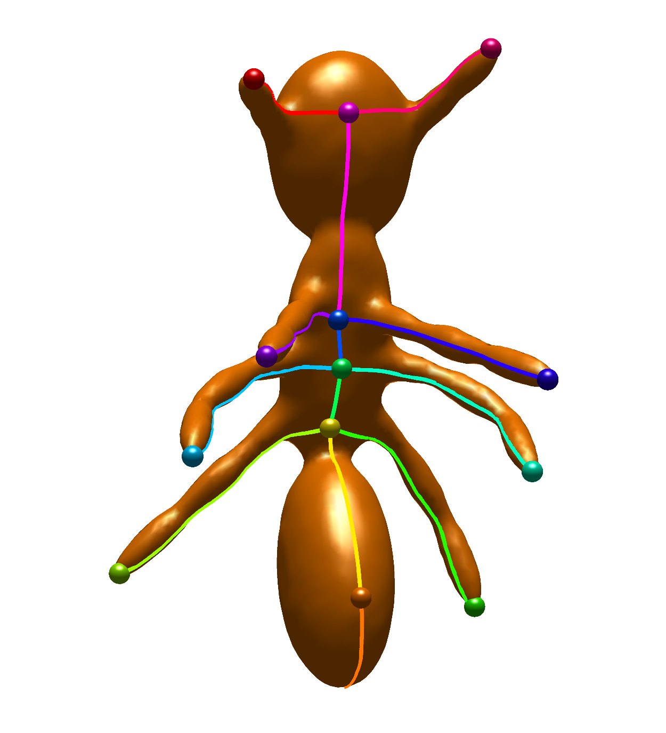
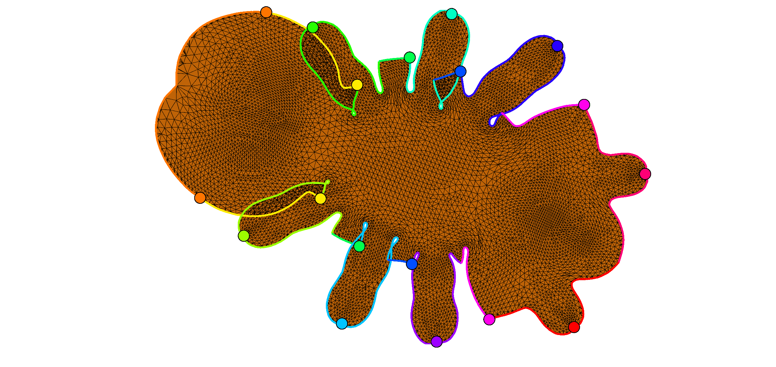

Overlaps
$$Ψ$$

Slide 21

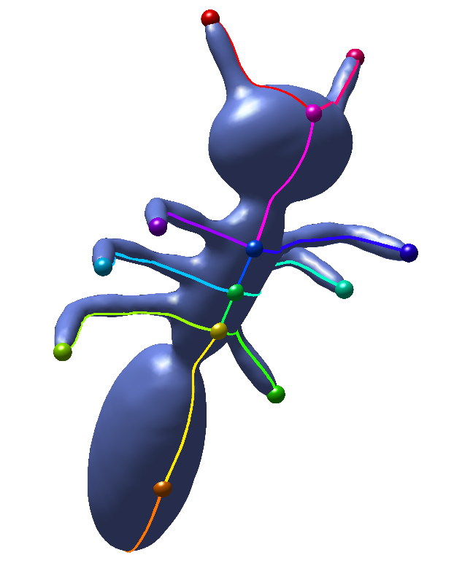
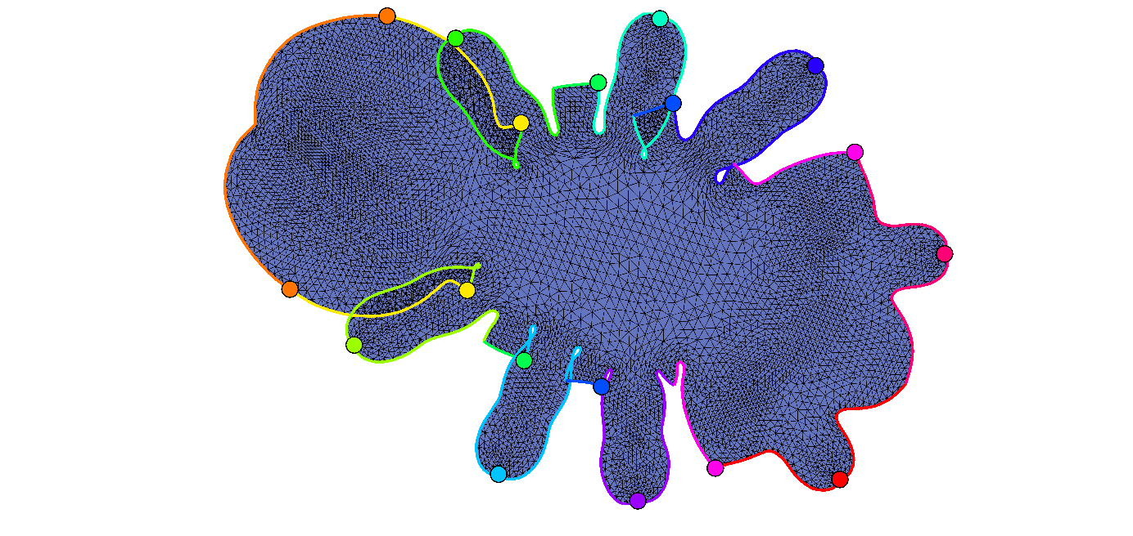



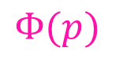






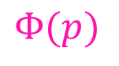
The non-injective case
$$f$$
$$=Ψ^{−1}∘Φ$$
?
$$z$$
We can still recover a bijection!
$$Φ$$
$$p$$
$$z$$
$$Ψ$$
$$Φ(p)$$
$$Φ(p)$$

Slide 22

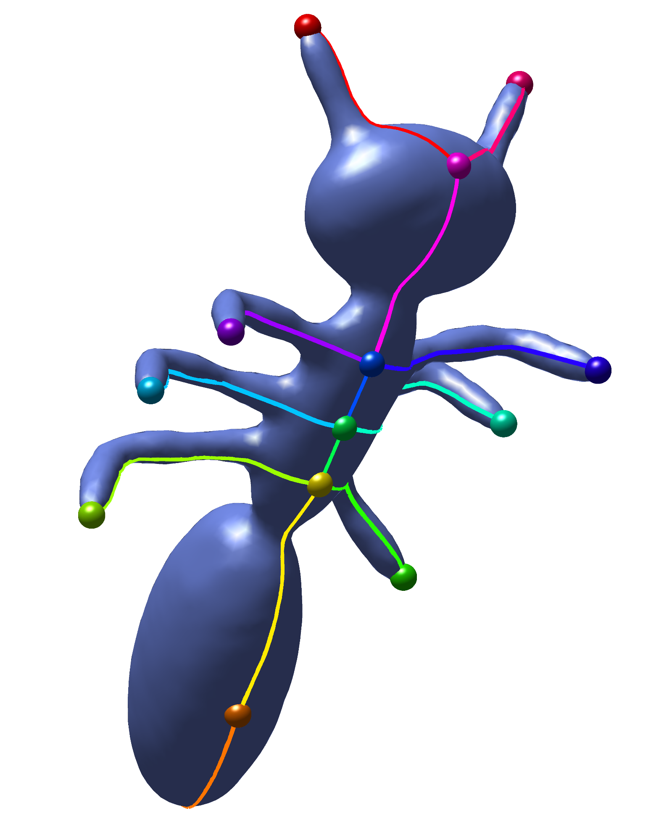
Idea: use liftings

Slide 23
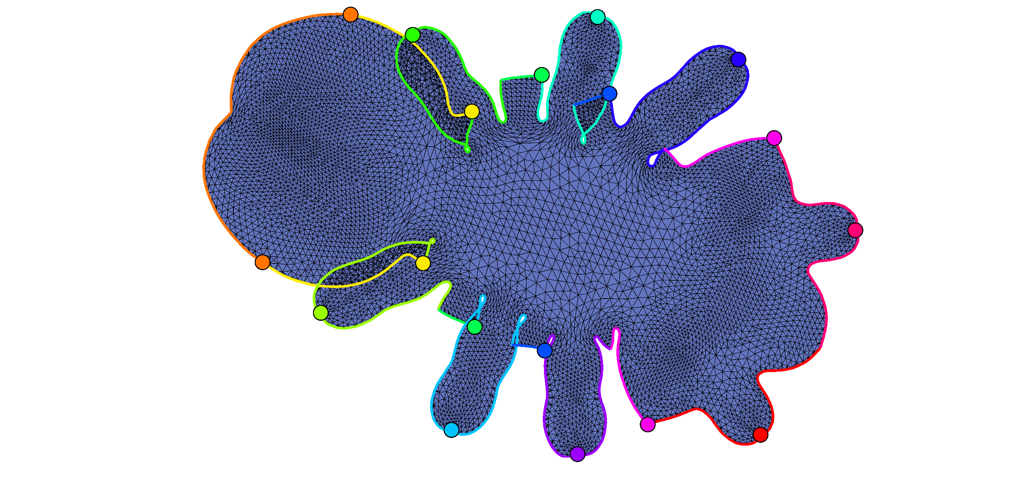




Idea: use liftings
$$p$$
$$Φ$$
$$Ψ$$

Slide 24

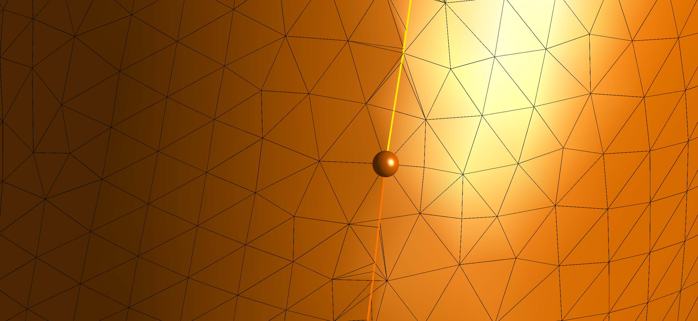
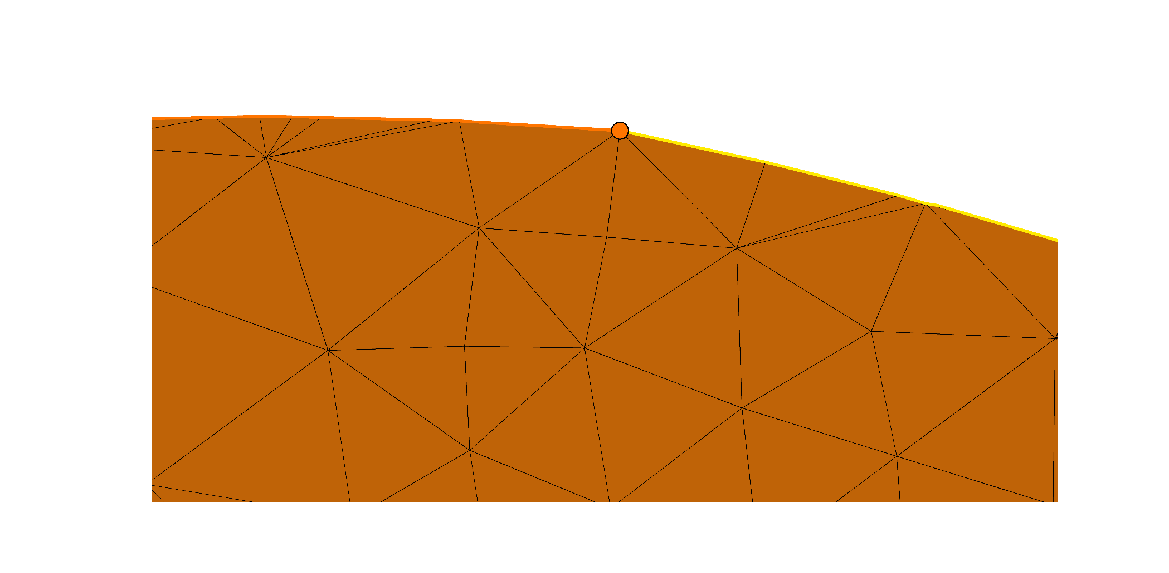
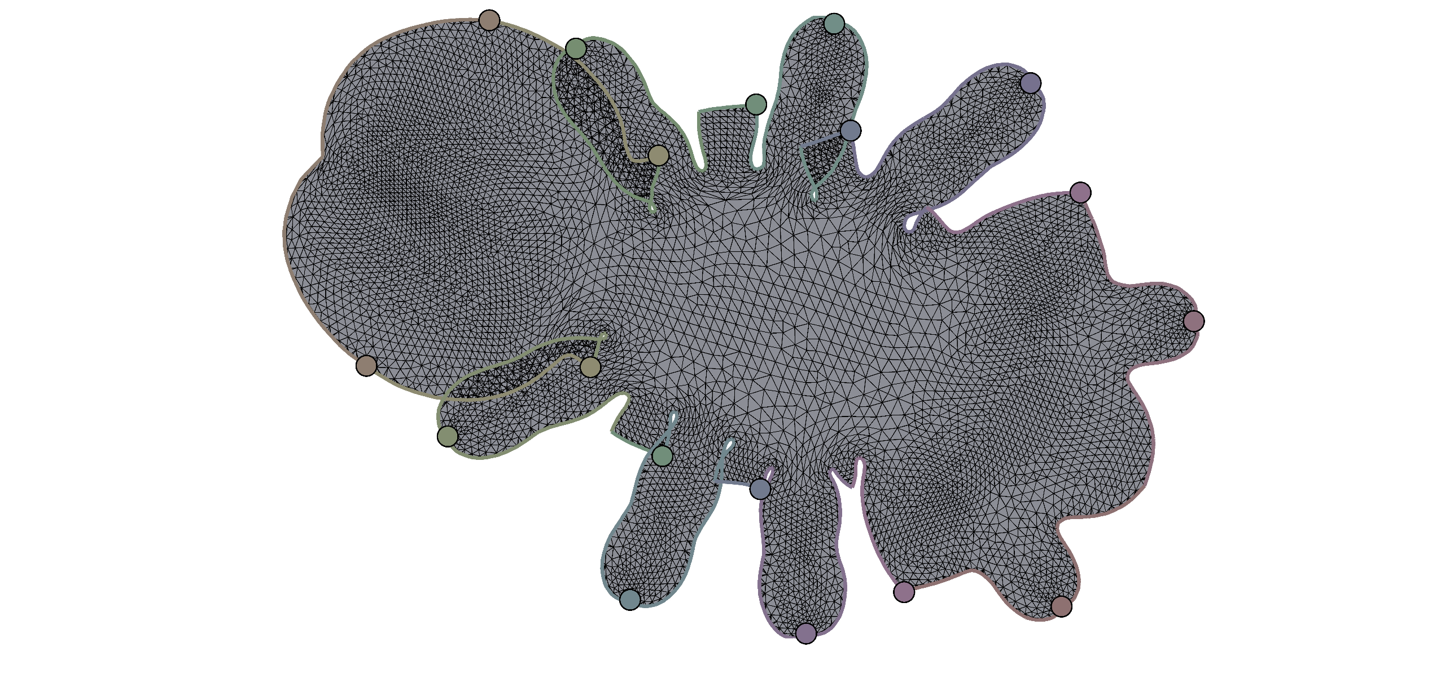


Idea: use liftings
$$Ψ$$
Locally Injective
$$p$$
$$Φ$$
$$Ψ$$

Slide 25
Idea: use liftings
$$p$$
$$Φ$$
$$Ψ$$

Slide 26
Idea: use liftings
$$p$$
$$Φ$$
$$Ψ$$

Slide 27
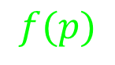
Idea: use liftings
$$p$$
$$f(p)$$
$$Φ$$
$$Ψ$$

Slide 28
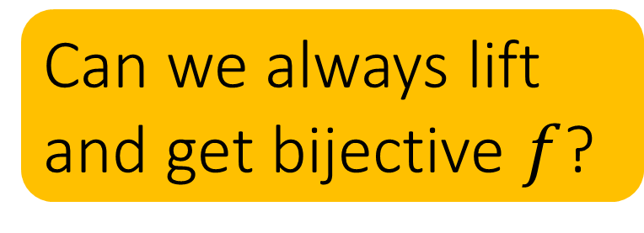
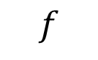
Idea: use liftings
$$p$$
$$f$$
$$f(p)$$
Can we always lift and get bijective $f$?
$$Φ$$
$$Ψ$$

Slide 29
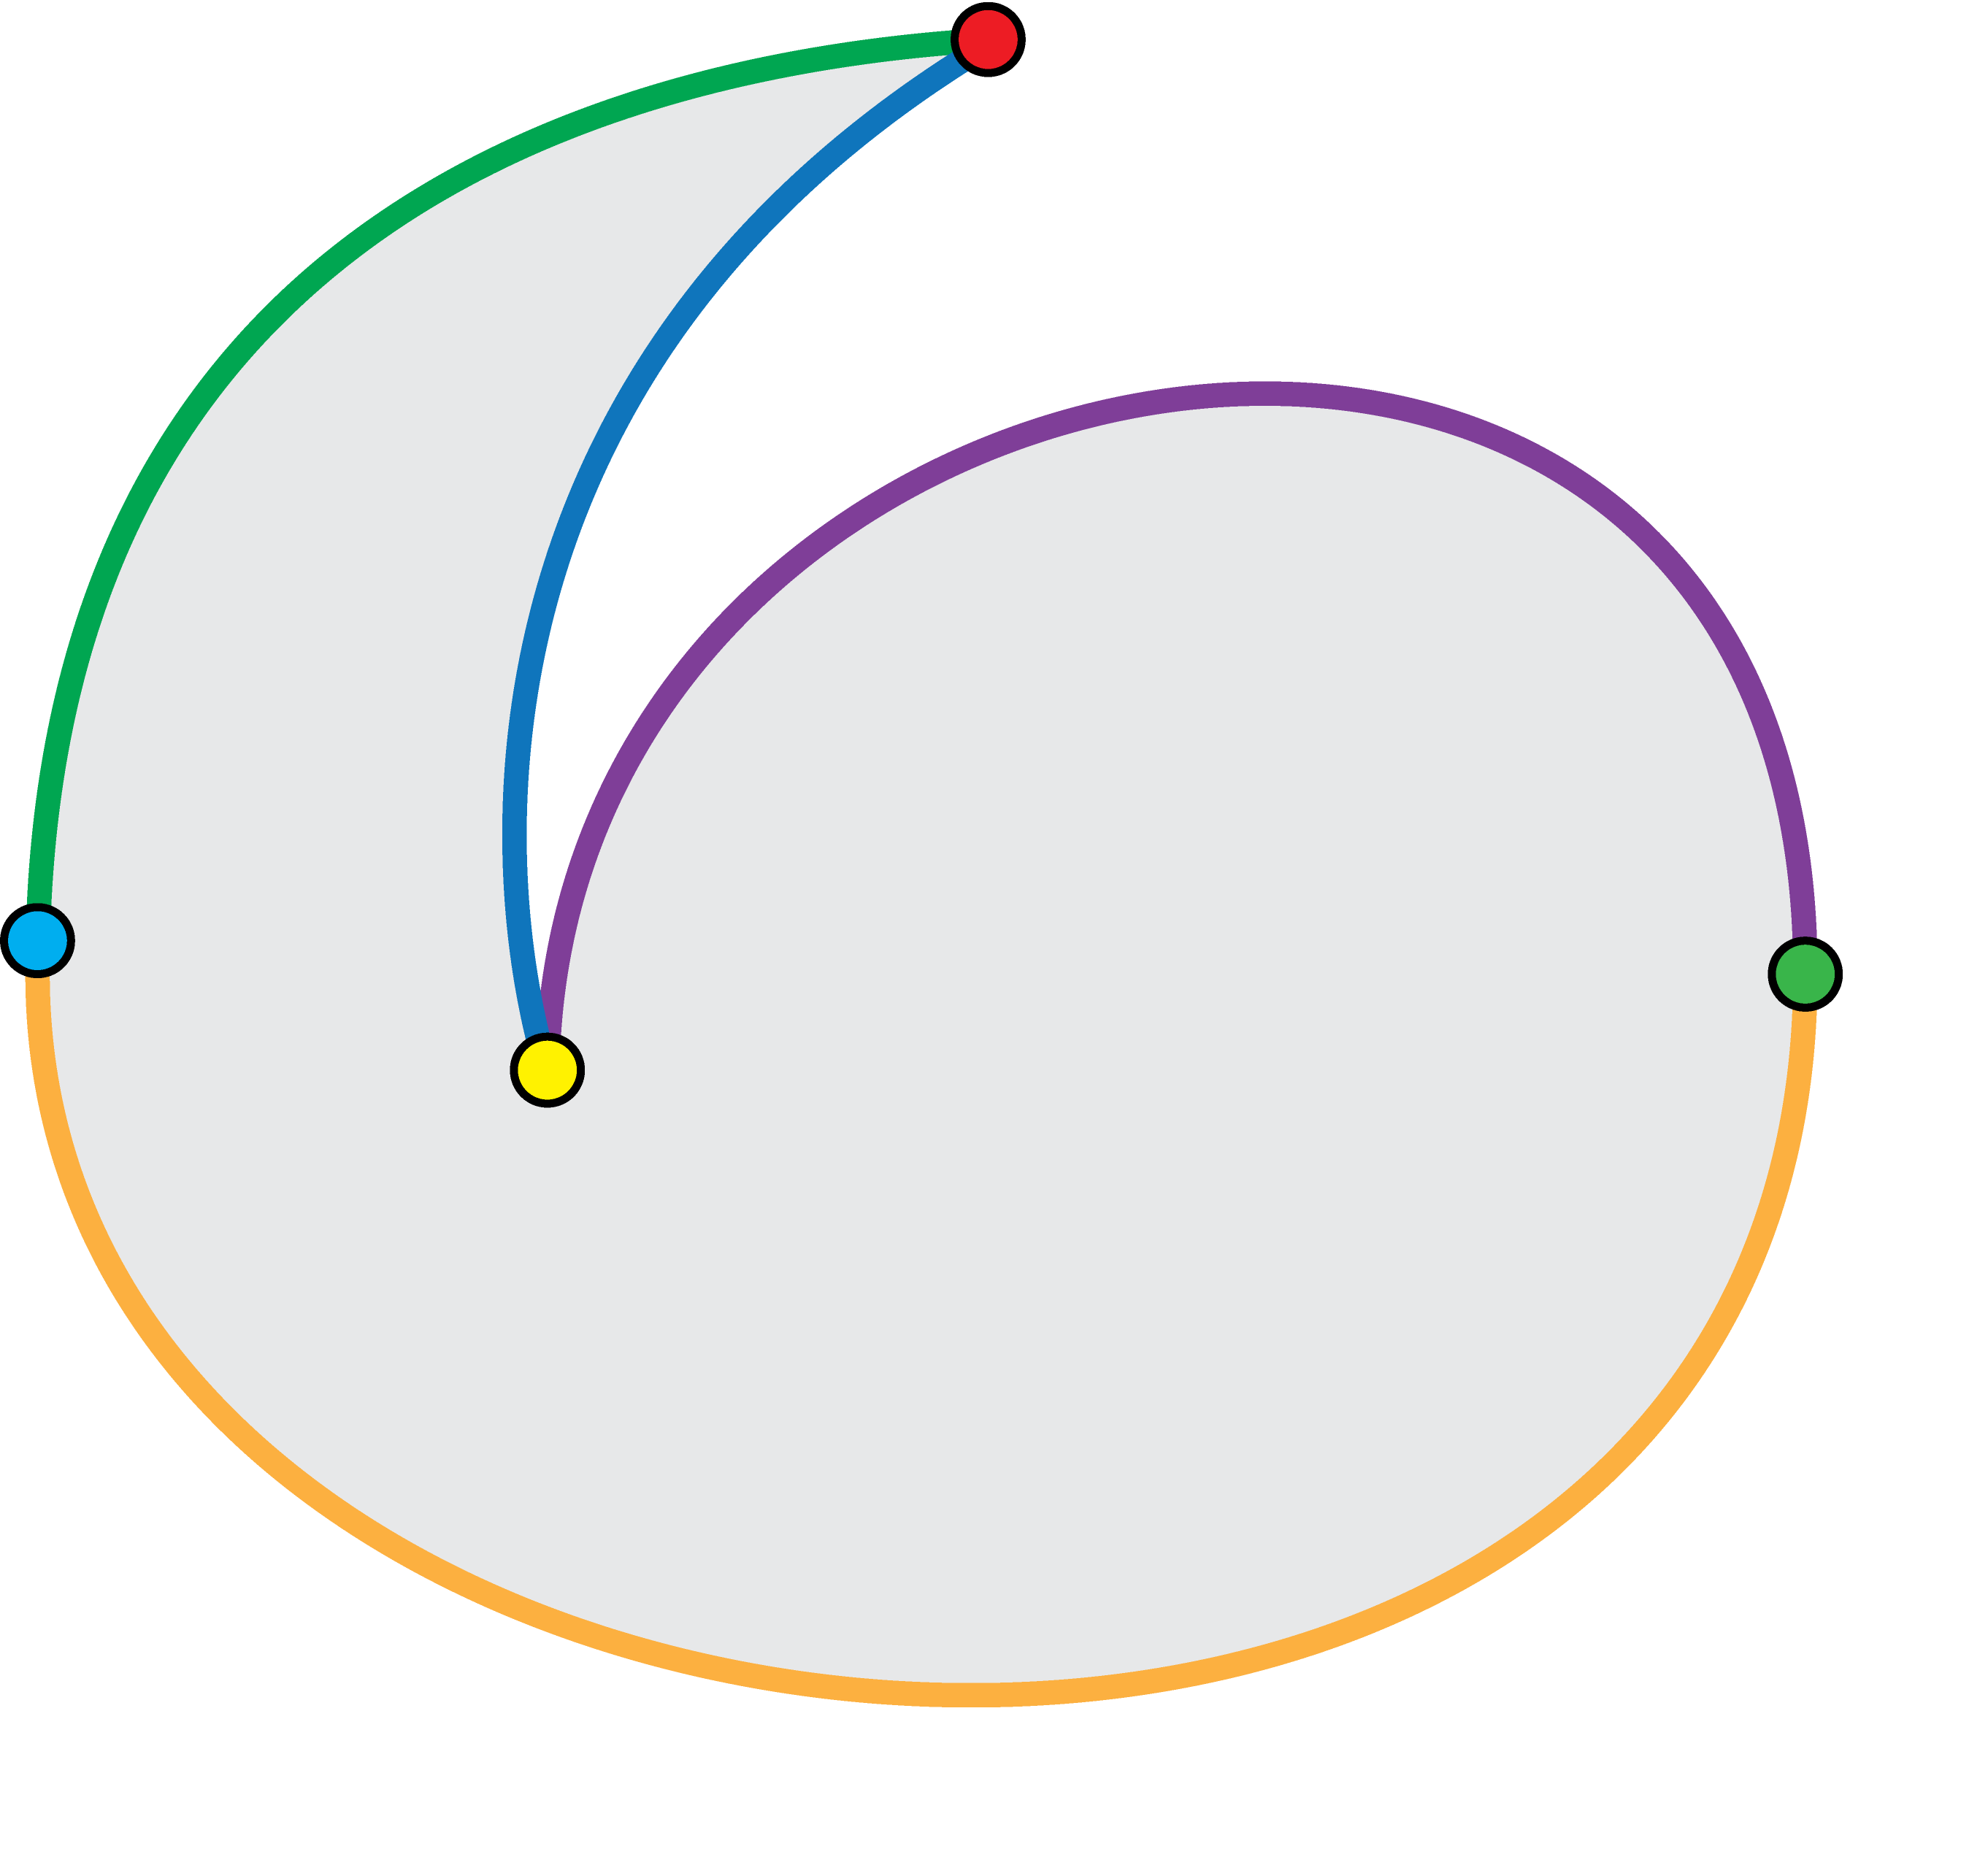
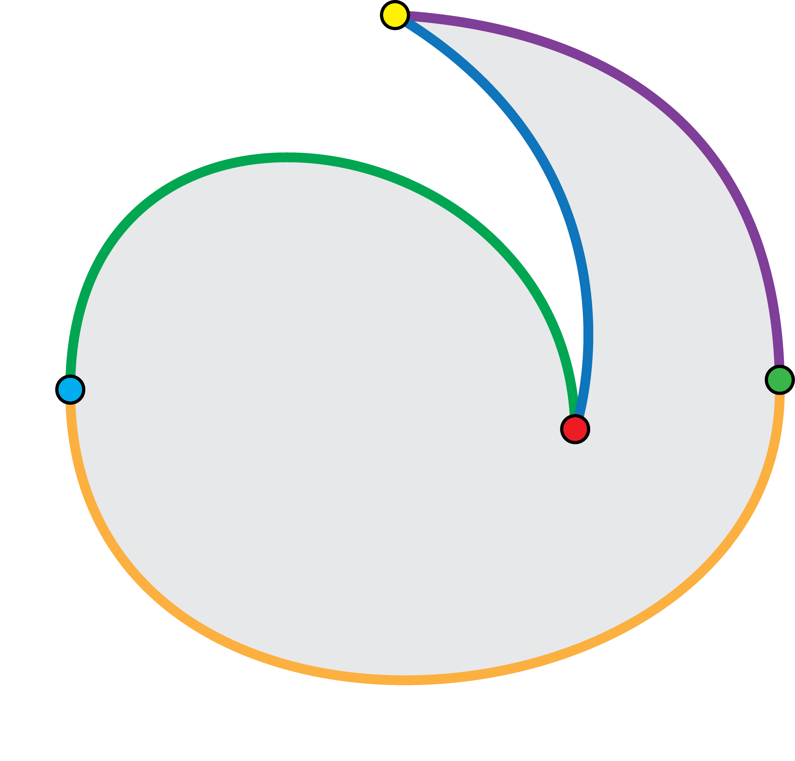
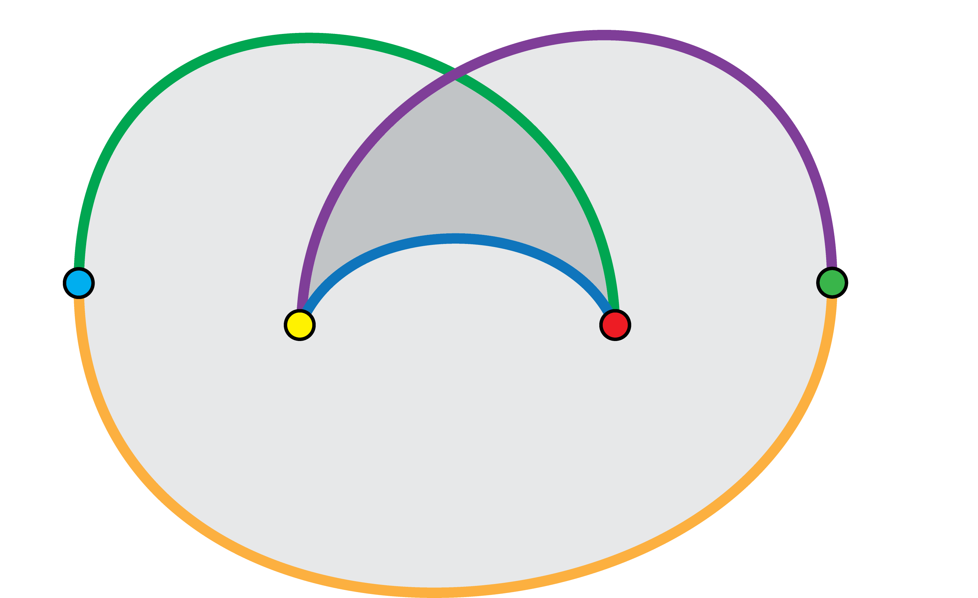

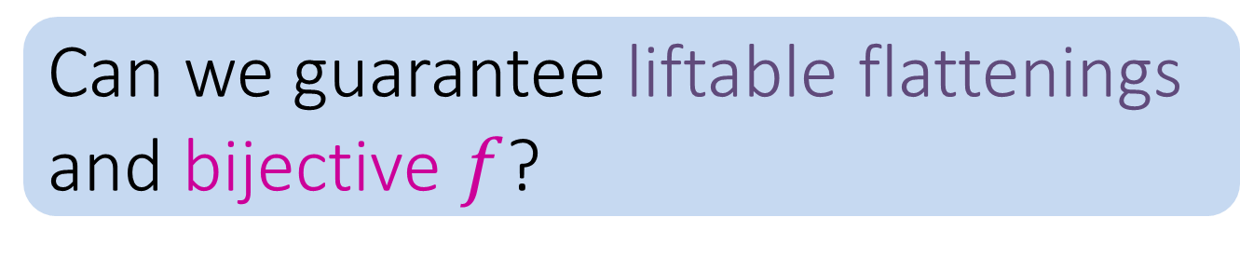




Flattenings can be non-liftable
$$N$$
$$M$$
$$p$$
Can we guarantee liftable flattenings and bijective $f$?
$$Φ$$
$$Ψ$$

Slide 30
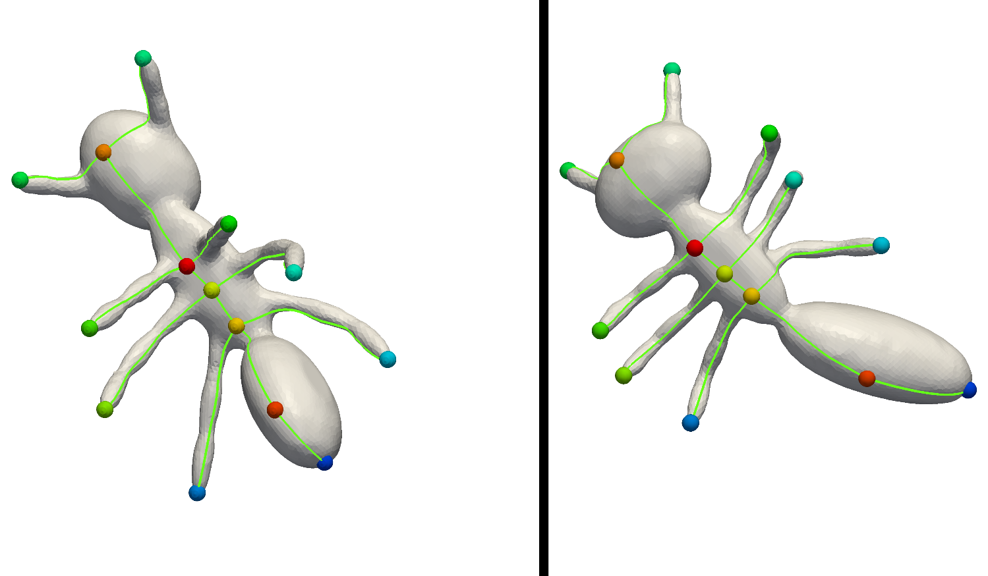

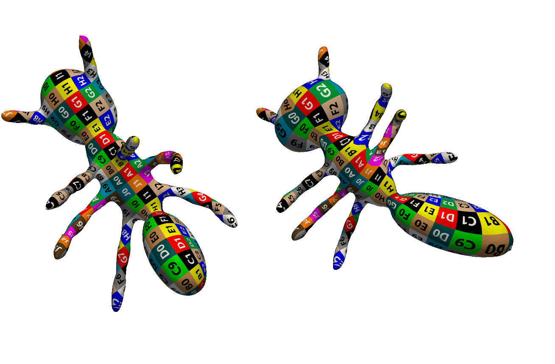

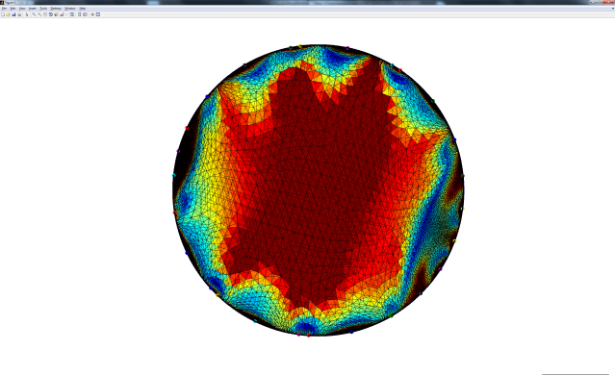
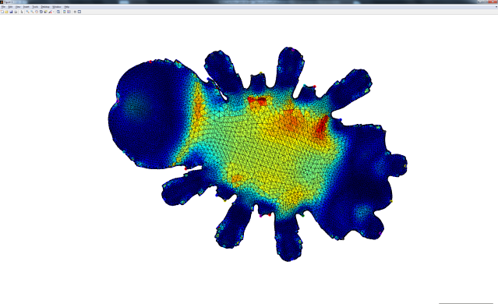
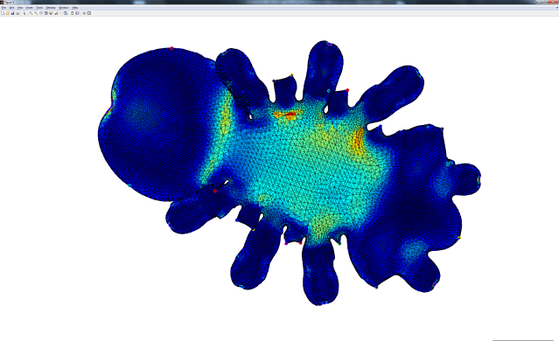


Theorem: Homotopy preserves liftability!
If:
Initialize from liftable
Deform the flattenings continuously, with local injectivity
Then:
Still liftable
Our optimization produces a locally injective homotopy!
Tutte’s embedding

Slide 31




Full pipeline
Input
Cut meshes
Homotopical optimization
of isometric distortion
(see paper)
Bijection Lifting

Slide 32
Full pipeline
Input
Cut meshes
Homotopical optimization
of isometric distortion
(see paper)
Bijection Lifting

Slide 33
Full pipeline
Input
Cut meshes
Homotopical optimization
of isometric distortion
(see paper)
Bijection Lifting

Slide 34
Full pipeline
Input
Cut meshes
Homotopical optimization
of isometric distortion
(see paper)
Bijection Lifting

Slide 35
Full pipeline
Guaranteed to produce a bijective mapping
Input
Cut meshes
Homotopical optimization
of isometric distortion
(see paper)
Bijection Lifting

Slide 36
Results…

Slide 37






Isometric dataset – SCAPE [Anguelov 04-05]
Source
SCAPE
Ours
Ours
SCAPE

Slide 38










Non-isometric dataset – SHREC07 [Giorgi 07]

Slide 39


Extreme

Slide 40

EXTREMELY EXTREME!

Slide 41

Conclusion
Two main contributions:
Flattenings can overlap
Locally injective optimization
Limitation: cut graph correspondence
Future: weaker conditions for bijections?

Slide 42















Thank you!
Funding:
European Research Council
I-CORE program of the Israel PBC
Israel Science Foundation

